Slide 1

OPTIMIZING WIND ENERGY PRODUCTION
Supervised Learning Approaches

Slide 2
OUTLINE
01
04
RESULT & INSIGHT
INTRODUCTION
02
05
DATA SOURCES & KEY FEATURES
CHALLENGES & FUTURE TRENDS
03
WORKFLOW
06
Week 3
Week 3
CONCLUSION

Slide 3

INTRODUCTION
Wind energy is a crucial renewable resource that contributes to sustainable power generation. This presentation explores supervised learning techniques that enhance energy prediction for wind turbines, ensuring effective optimization of the abundant resources. We will discuss methodologies, application and outcomes of this approaches.

Slide 4

Benefits Of Wind Energy
Environmental Benefits
Reduces greenhouse gas emissions
Economic Benefits
Stabilizes energy prices by reducing dependency on fossil fuels
Operational Benefits
Rapid deployment: Wind turbines can be installed relatively quickly

Slide 5
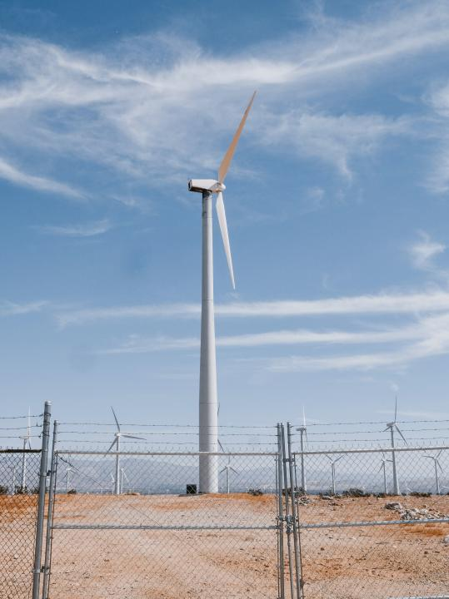
Importance of Energy Prediction
Accurate energy prediction is vital for optimizing wind energy production. It helps in grid stability, effective resources management, and reducing operational costs. By utilizing predictive models, we can foresee energy output and improve decision-making processes in energy distribution.

Slide 6

Data Sources
Historical weather data collected from weather stations and meteorological services in Texas, USA.

Slide 7
Key Features
Timestamp:
Captures the date and time of each observation.
Essential for understanding temporal patterns and trends in energy production.
Helps in modeling time-series data and identifying seasonal variations.
Pressure:
Affects air density, which in turn impacts the amount of energy extracted from the wind.
Higher pressure typically means higher air density and potentially more energy.

Slide 8
Key Features
Temperature:
Influences air density (colder air is denser).
Variations in temperature can lead to changes in turbine efficiency and energy output.
Wind Speed:
The primary driver of energy generation.
Directly proportional to the amount of energy produced (energy output increases with the cube of wind speed).
Measured at different heights (e.g., 10m, 50m, hub height).

Slide 9
Key Features
Wind Direction:
Affects turbine orientation and efficiency.
Knowing the predominant wind direction helps in optimal turbine placement and orientation.

Slide 10
Workflow
01
02
04
05
07
Data Loading & Understanding
Modelling
Cleaning the Data
Exploratory Data Analysis
Model Selection
03
06
Feature Engineering
Hyperparameter Tuning

Slide 11

Machine Learning Model Used
Linear Regression
Random Forests
Gradient Boosting
Support Vector Regressor

Slide 12

Evaluation Metrics
Mean Absolute Error (MAE)
Mean Square Error (MSE)

Slide 13
RESULT & INSIGHT
s/n | Model | Mean Square Error | Mean Absolute
1 | Random Forest | 136.144541 | 5.455934
2 | Support Vector Machine | 608393.416849 | 620.656366
3 | Linear Regressor | 80965.275936 | 228.931772
4 | Gradient Boosting Regressor | 70.141956 | 5.730217

Slide 14
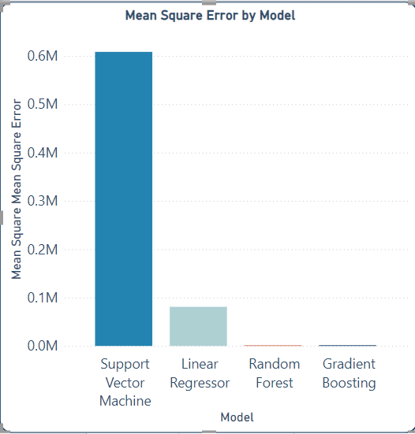
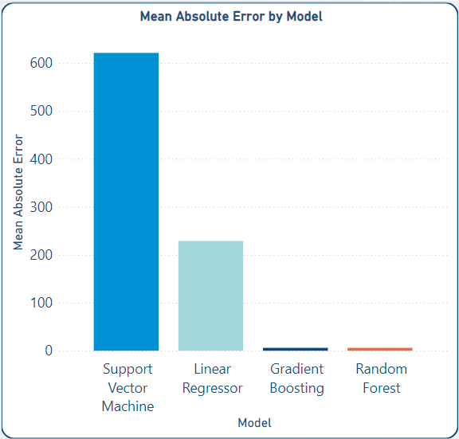
RESULT & INSIGHT

Slide 15

Best-performing Model
Gradient boosting is a machine learning ensemble technique that combines the predictions of multiple weak learners, typically decision trees, sequentially.
It aims to improve overall predictive performance by optimizing the model’s weights based on the errors of previous iterations, gradually reducing prediction errors and enhancing the model’s accuracy.

Slide 16
Best-performing Model
The process used to select the best model Evaluation metrics and Hyperparameter tuning. The key hyperparameters and their optimal values:
n_estimators = 284
max_depth = 15
learning_rate = 0.028193916434926043
subsample = 0.14157727141089976
random_state = 42

Slide 17
Key Insight
Feature Importance:
Wind speed have the highest impact on energy output.
Seasonal Variations:
Higher energy output in spring and winter due to optimal wind conditions.

Slide 18

Challenges in Implementation
Despite the benefits, there are challenges in implementing supervised learning for wind energy prediction. Issues such as data quality, model complexity, and computational costs can hinder effective deployment. Addressing these challenges is crucial for maximizing the potential of predictive models.

Slide 19

The future of wind energy production lies in integrating advanced algorithms and big data analytics. Emerging technologies like deep learning and IoT will further enhance predictive capabilities, leading to more effective energy management and sustainable practices in the sector
Future Trends

Slide 20

Conclusion
Predicting wind energy output is crucial for optimizing the performance and efficiency of wind turbine systems.
These models can provide more precise and reliable forecasts, ultimately leading to more efficient wind energy utilization.
Using machine learning models significantly improves the accuracy of these predictions compared to traditional methods.

Slide 21

“We can create a more sustainable, cleaner and safer world by making wiser energy choices”

Slide 22

THANK YOU!
QUESTIONS?

